Slide 1


MODFLOW 6 Unstructured Grids
47TH IAH Congress
São Paulo, Brazil
August 22, 2021
Notes:
Describe some of the ongoing work we are doing with MODFLOW
MODFLOW and related software distributed by the USGS is developed and supported by a growing team of USGS scientists and external collaborators. Recent MODFLOW development efforts have focused on use of unstructured and locally refined grids for constant or variable-density groundwater flow and solute transport simulation, robust handling of three-dimensional anisotropy, generalization and tracking of water transfer between packages, distributed memory parallelization, and consolidation of these core capabilities into MODFLOW 6. These capabilities make it possible to construct new types of models, such as tightly coupled nested models, that have not been possible with previous MODFLOW versions. Underlying these efforts has been the adoption of an open-development philosophy that relies on testing-based development and continuous integration practices by the core development team and by the broader MODFLOW community. Ongoing development increasingly relies on the Flopy python package for automating model construction. Resulting from these development efforts is a suite of MODFLOW programs that can be applied at local, regional, and National scales for a wide variety of complex groundwater flow and transport problems.
OASIS MCT

Slide 2
MODFLOW 6 Unstructured Grids

Slide 3
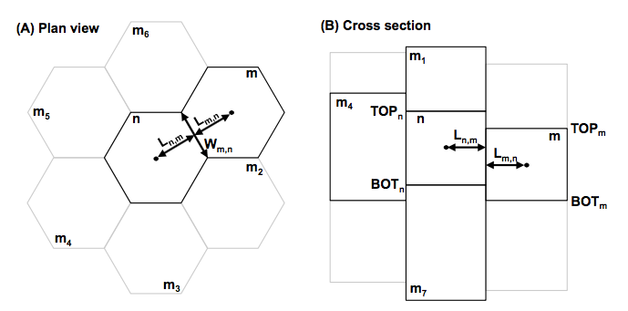
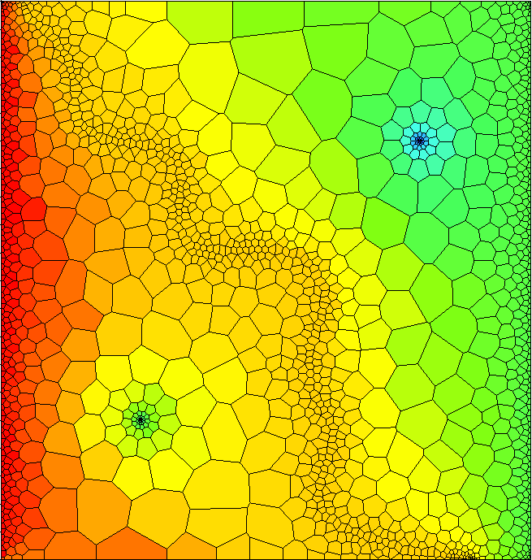
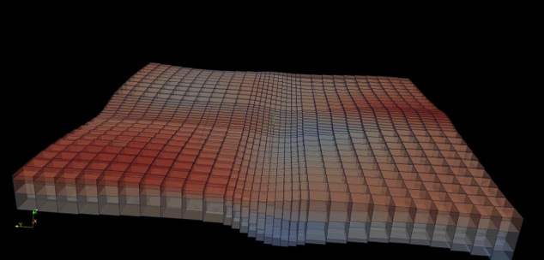
Spatial Discretization
Three ways to enter grid
DIS – regular MODFLOW grid
DISV – discretization by vertices
DISU – fully unstructured

Slide 4
Unstructured Grids
What do we mean by unstructured?
1. Cell can be connected to any number of surrounding cells
2. Not a regular MODFLOW grid
Why use them?
Grid can conform to irregular model domain boundaries
Resolution can be added in areas of interest
Why not use them?
More complicated to work with
Poor grid design can lead to errors in the flow solution that are difficult to find and quantify

Slide 5
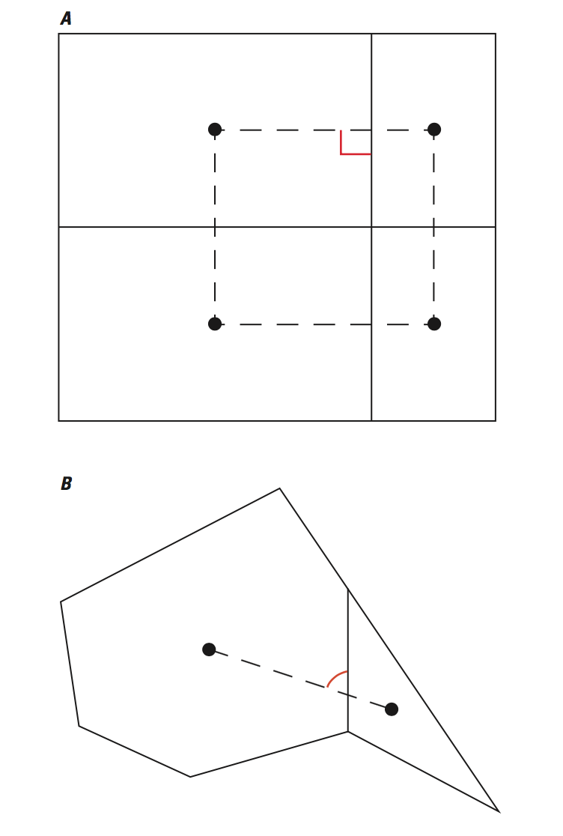
CVFD Requirements
Good
Connecting line bisects shared edge at right angle
Possible issues

Slide 6
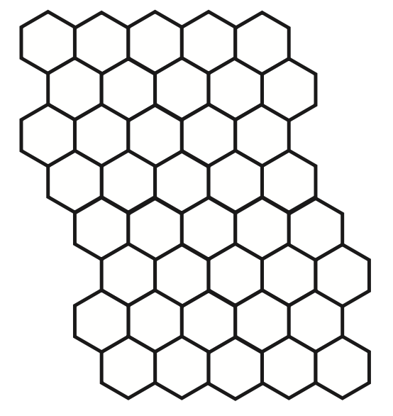
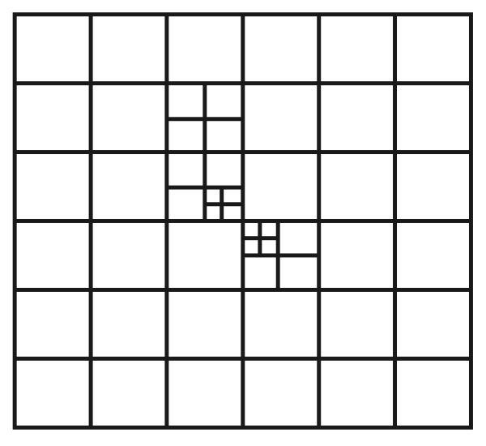
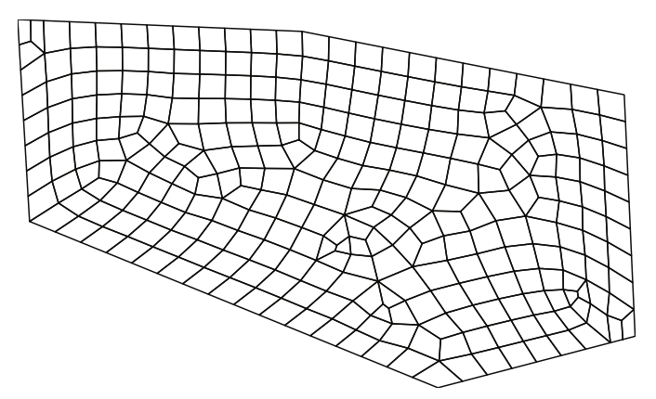
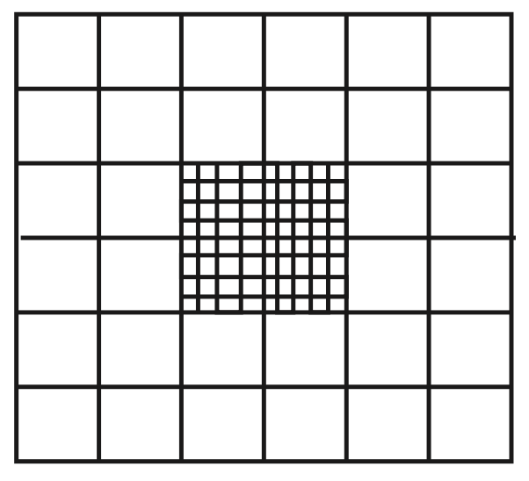
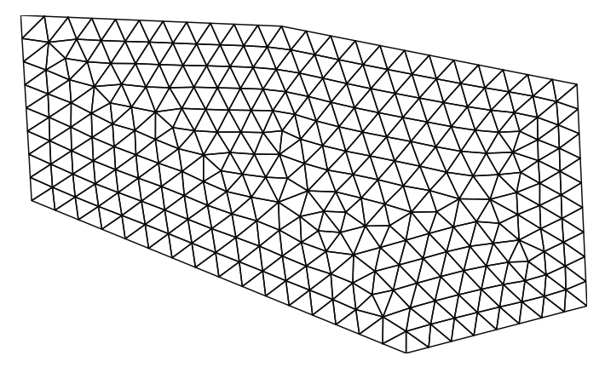
Types of Unstructured Grids
Rectangular based
Quadpatch
Quadtree / Octree
Triangular
Voronoi
Others

Slide 7
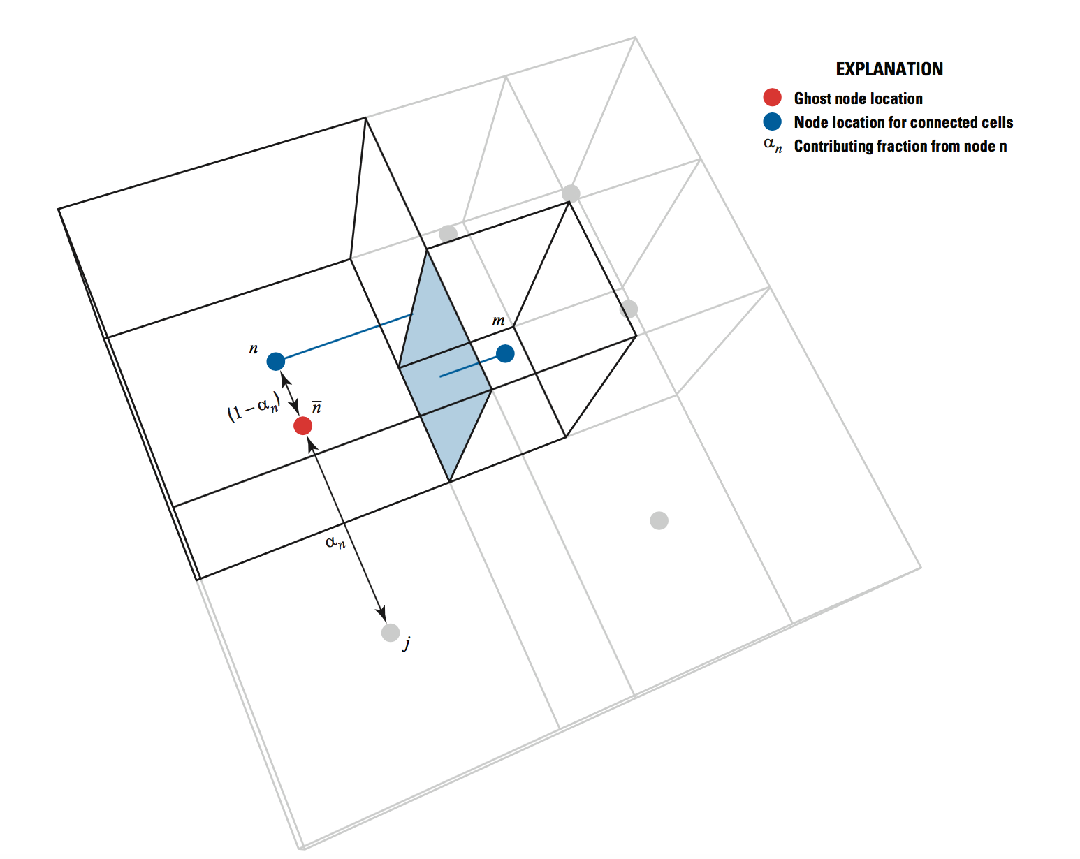
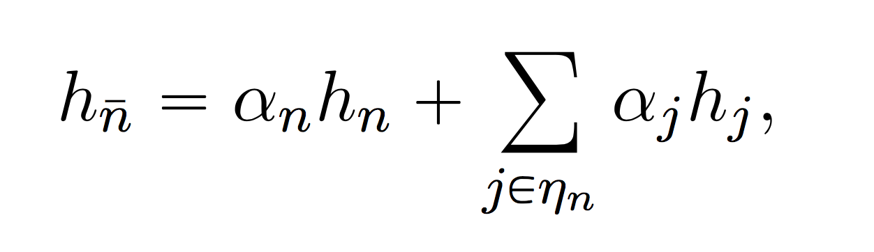
Ghost-Node Correction
Can be used to correct the flow calculation when the CVFD requirement is violated

Slide 8
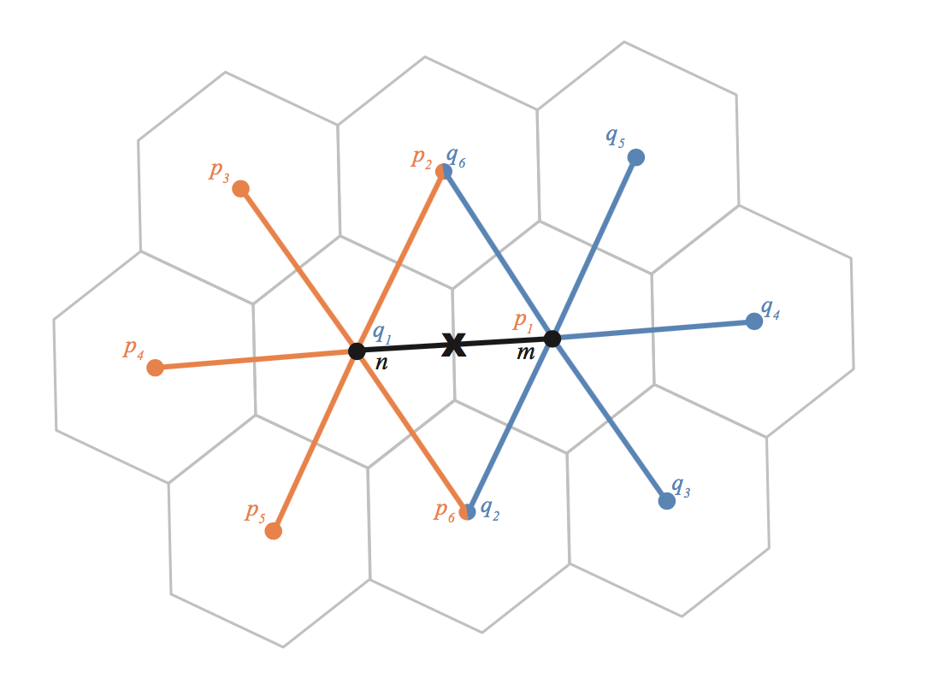
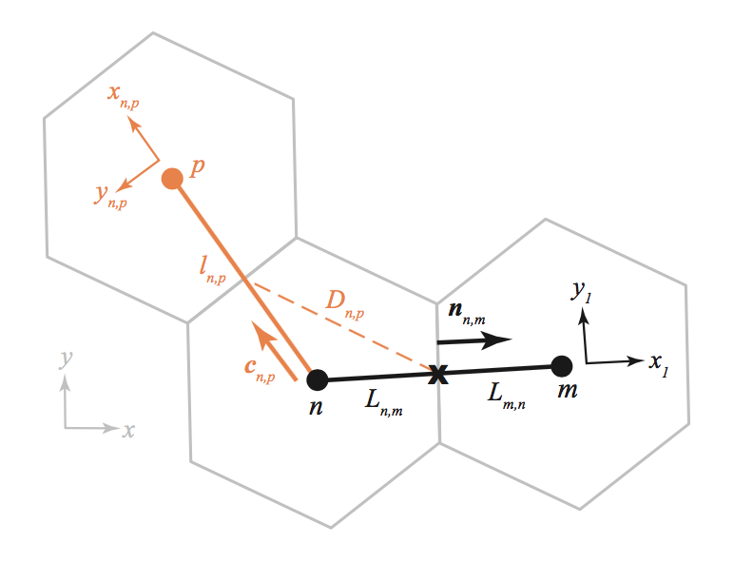
XT3D
Sophisticated flow formulation designed to handle full 3D anisotropy
XT3D also improves flow solution for grids that do not honor the CVFD requirements

Slide 9
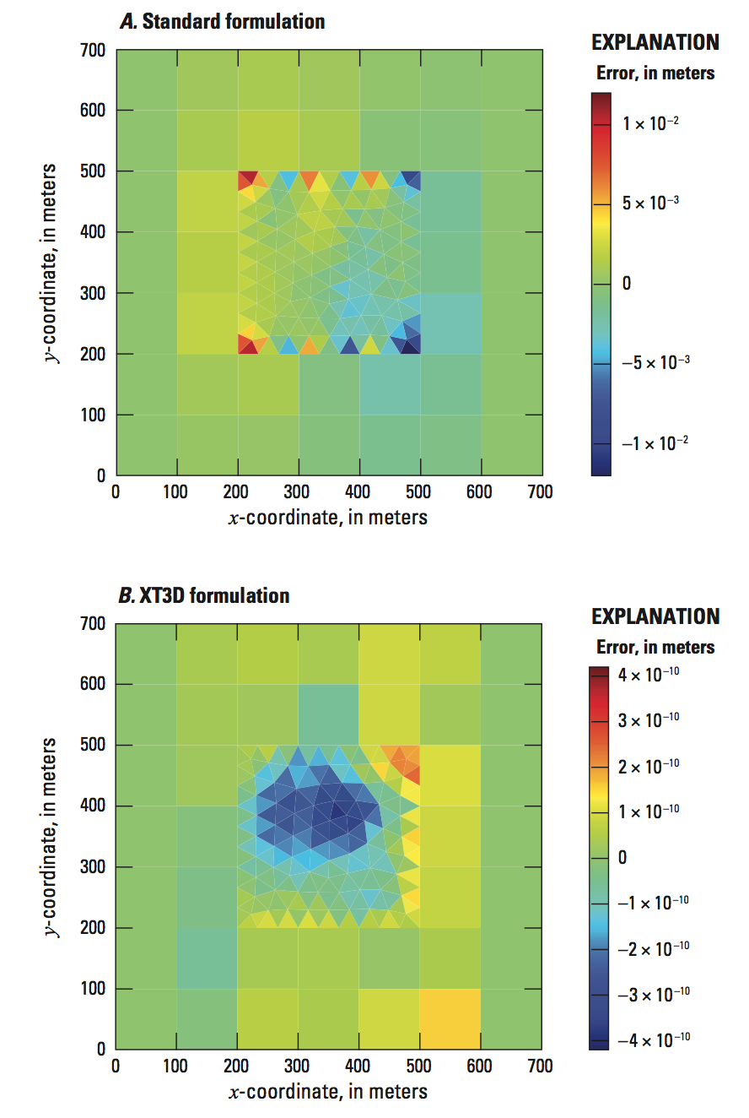
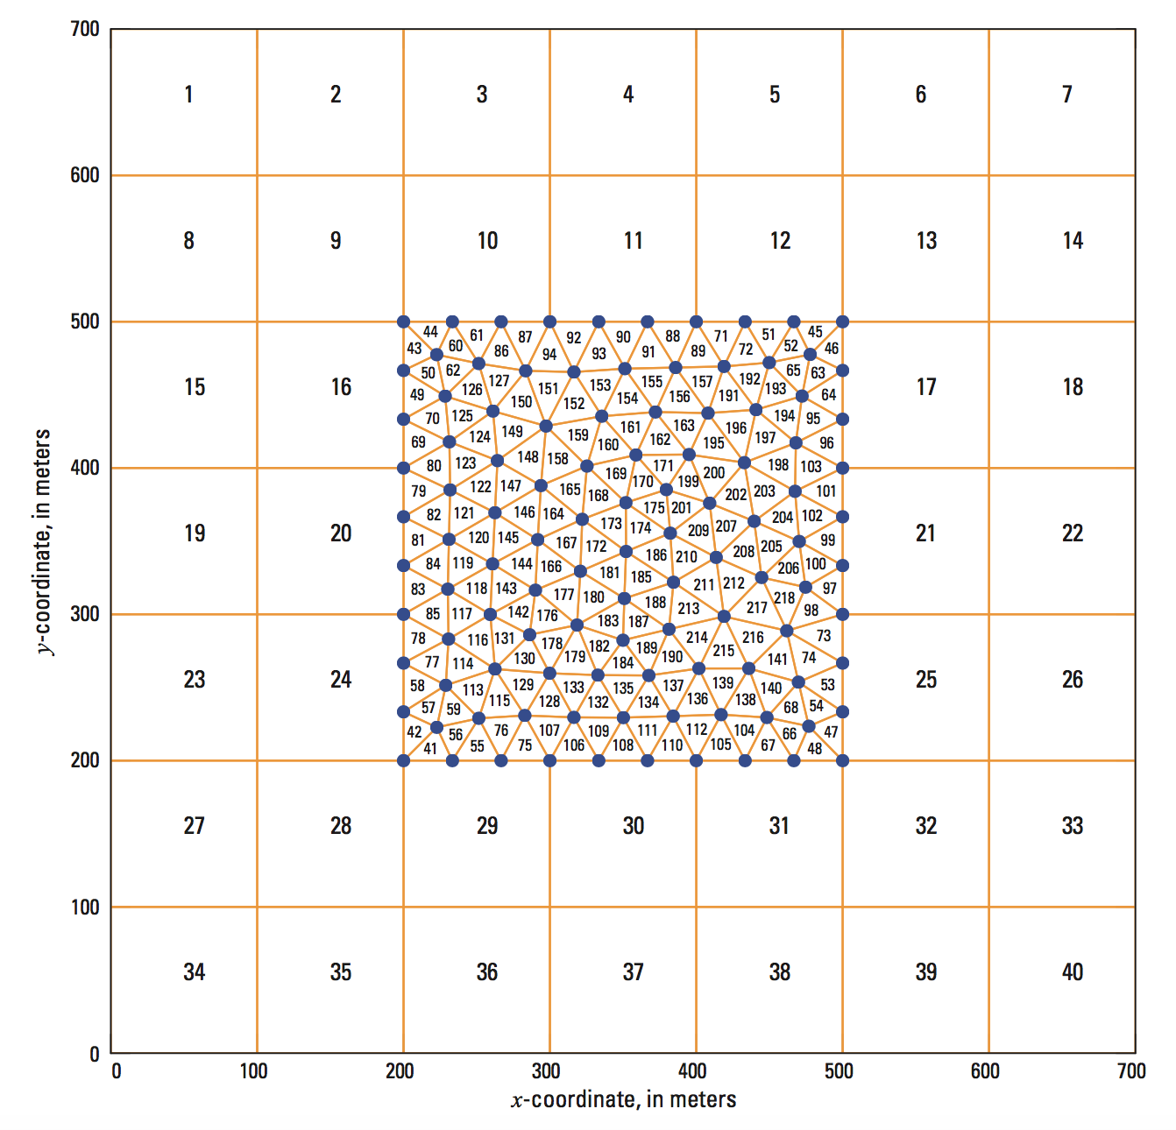
XT3D Solution

Slide 10
Unstructured Grids in MODFLOW 6
Discretization by Vertices (DISV) Package
New in MODFLOW 6
Unstructured Discretization (DISU) Package
Patterned after approach in MODFLOW-USG
Multiple models

Slide 11
“CELLID”
Regular MODFLOW grid (DIS)
(LAYER, ROW, COLUMN)
Discretization by Vertices (DISV)
(LAYER, CELL NUMBER)
Unstructured Discretization (DISU)
(CELL NUMBER)

Slide 12
DISV package

Slide 13
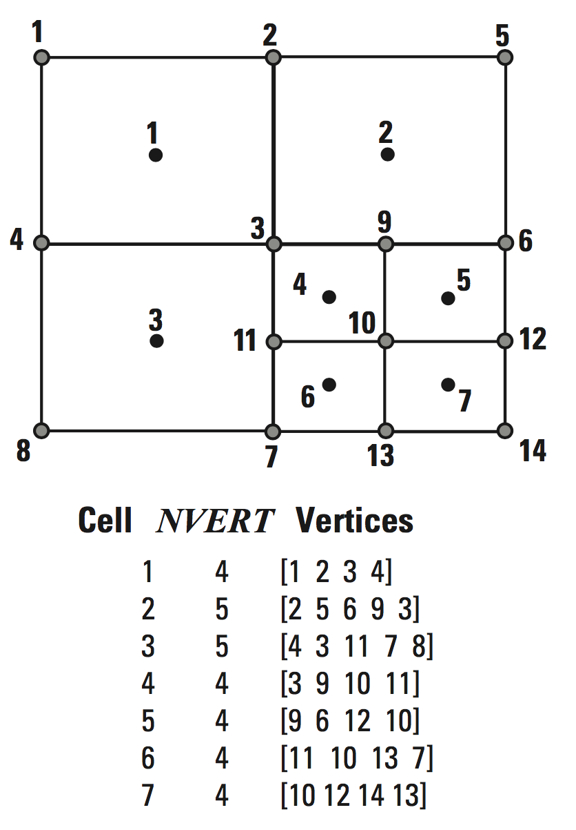
Vertices and Cells

Slide 14
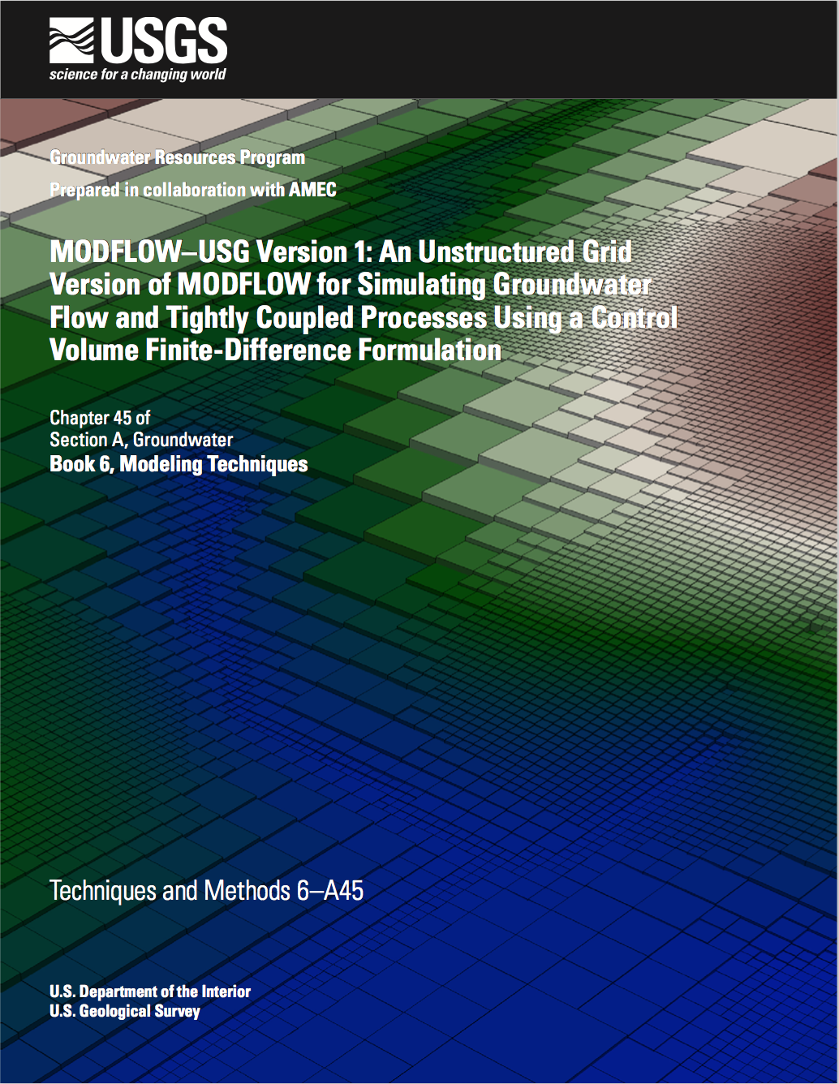
DISU Package

Slide 15
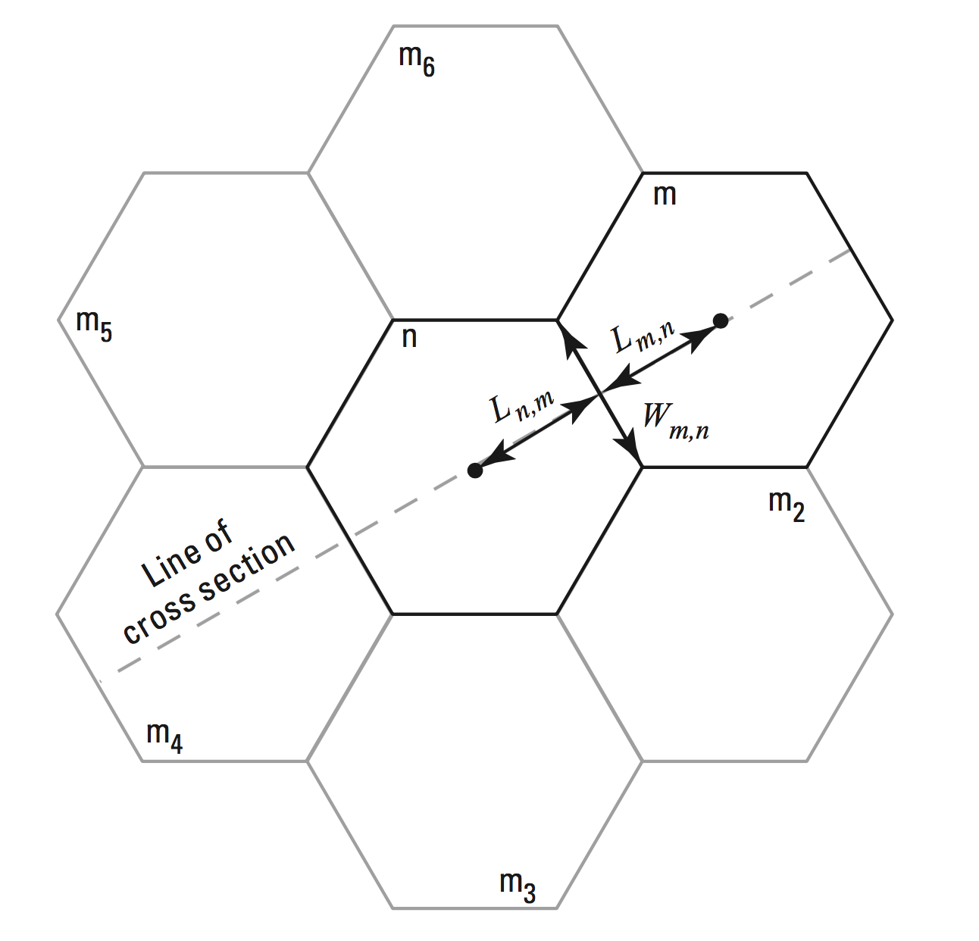
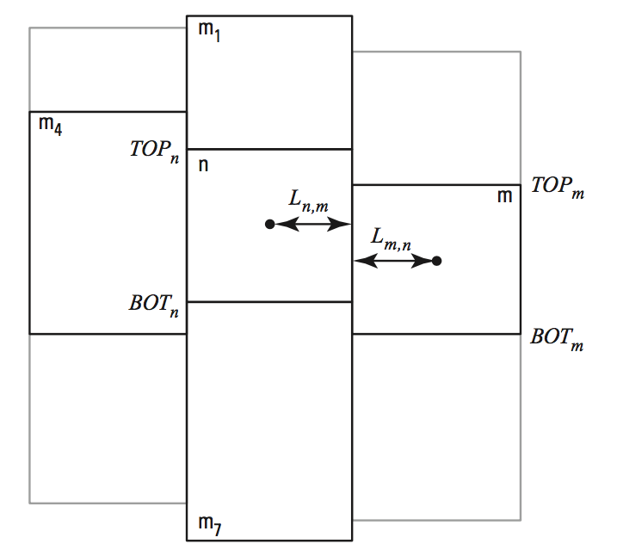
DISU Connections

Slide 16
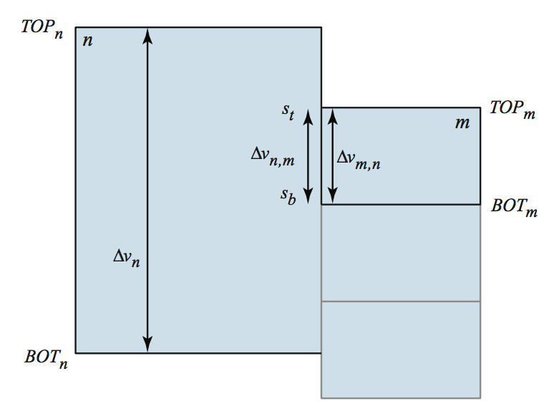
DISU Vertically Staggered Connections
Cell can be connected to more than one cell in a single horizontal direction

Slide 17
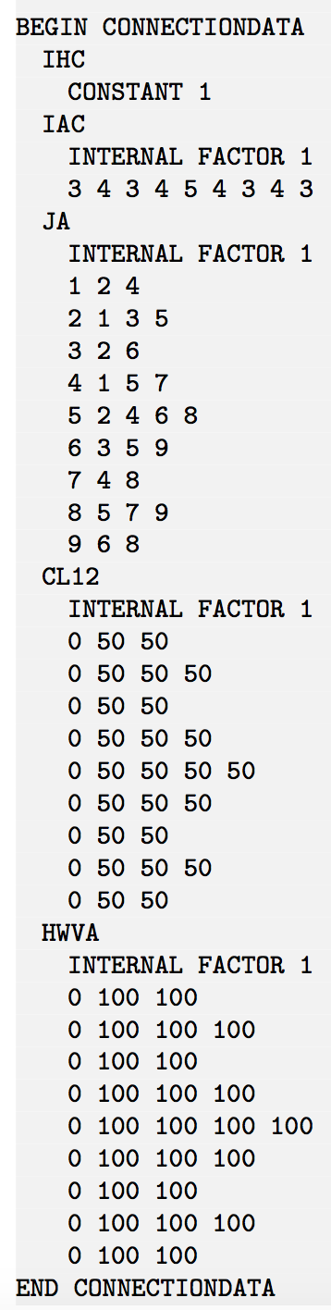
DISU Connection Data
1
2
3
4
5
6
7
8
9

Slide 18
Local Grid Refinement: Multi-model simulation A compromise….

Slide 19
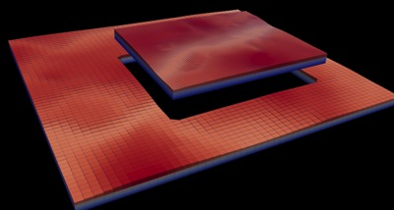
Multi-Model Simulation
MODFLOW 6 foundation allows models to be tightly coupled at the matrix level
Allows local grid refinement (LGR), and other model coupling strategies

Slide 20
LGR Simulation
Simulation
Temporal Discretization
PARENT
C1
C2
GC
Iterative Model Solution

Slide 21
GWF Exchanges
Simulation
Temporal Discretization
PARENT
C1
C2
GC
Iterative Model Solution
PARENT-C1
PARENT-C2
C1-GC

Slide 22
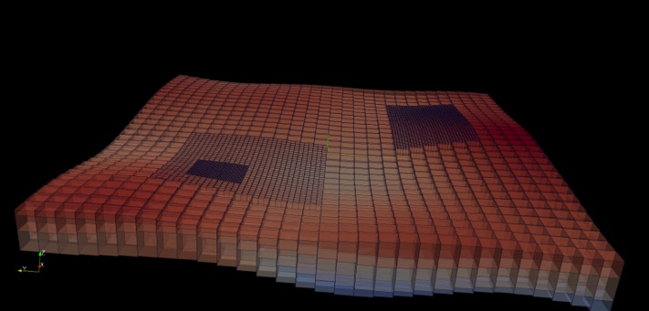
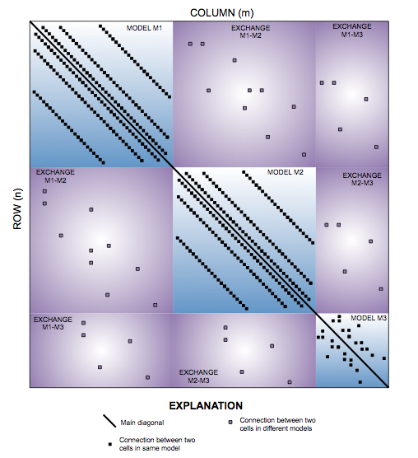
Matrix-Level Coupling
Simulation
Temporal Discretization
PARENT
C1
C2
GC
Iterative Model Solution
PARENT-C1
PARENT-C2
C1-GC
Notes:
Because our solver is unstructured and asymmetric, can handle Newton-Raphson, unstructured grids, ghost nodes, XT3D, dispersion tensors, etc…

Slide 23
QUESTIONS?

